Slide 1

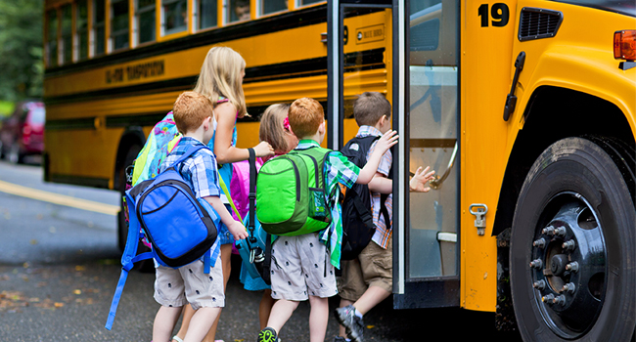





The Smart
School Bus
Introduction
Team Contributions
Conclusion
UI Design
Future Work

Slide 2


Slide 3

Introduction
Introduction
Our Goals

Slide 4

Introduction
Introduction
Introduction
Our Goals

Slide 5



Introduction
It’s a web-application that allows to transfer students from/to the school by using modern technology.
Introduction
Introduction
Our Goals

Slide 6
Introduction
It’s a web-application that allows to transfer students from/to the school by using modern technology.
Introduction
Introduction
Our Goals

Slide 7
Introduction
Introduction
Introduction
Our Goals

Slide 8
Introduction
Save Time
Introduction
Our Goals

Slide 9
Introduction
Save Time
Social Acceptance
Introduction
Our Goals

Slide 10
Introduction
Save Time
Social Acceptance
Reduce Traffic
Introduction
Our Goals

Slide 11
Introduction
Save Time
Social Acceptance
Reduce Traffic
Introduction
Our Goals
More Safety

Slide 12


Slide 13
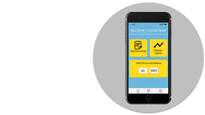




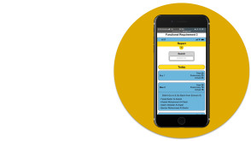

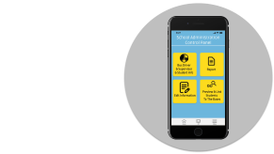

UI Design
Functional Requirements
& Snapshots

Slide 14
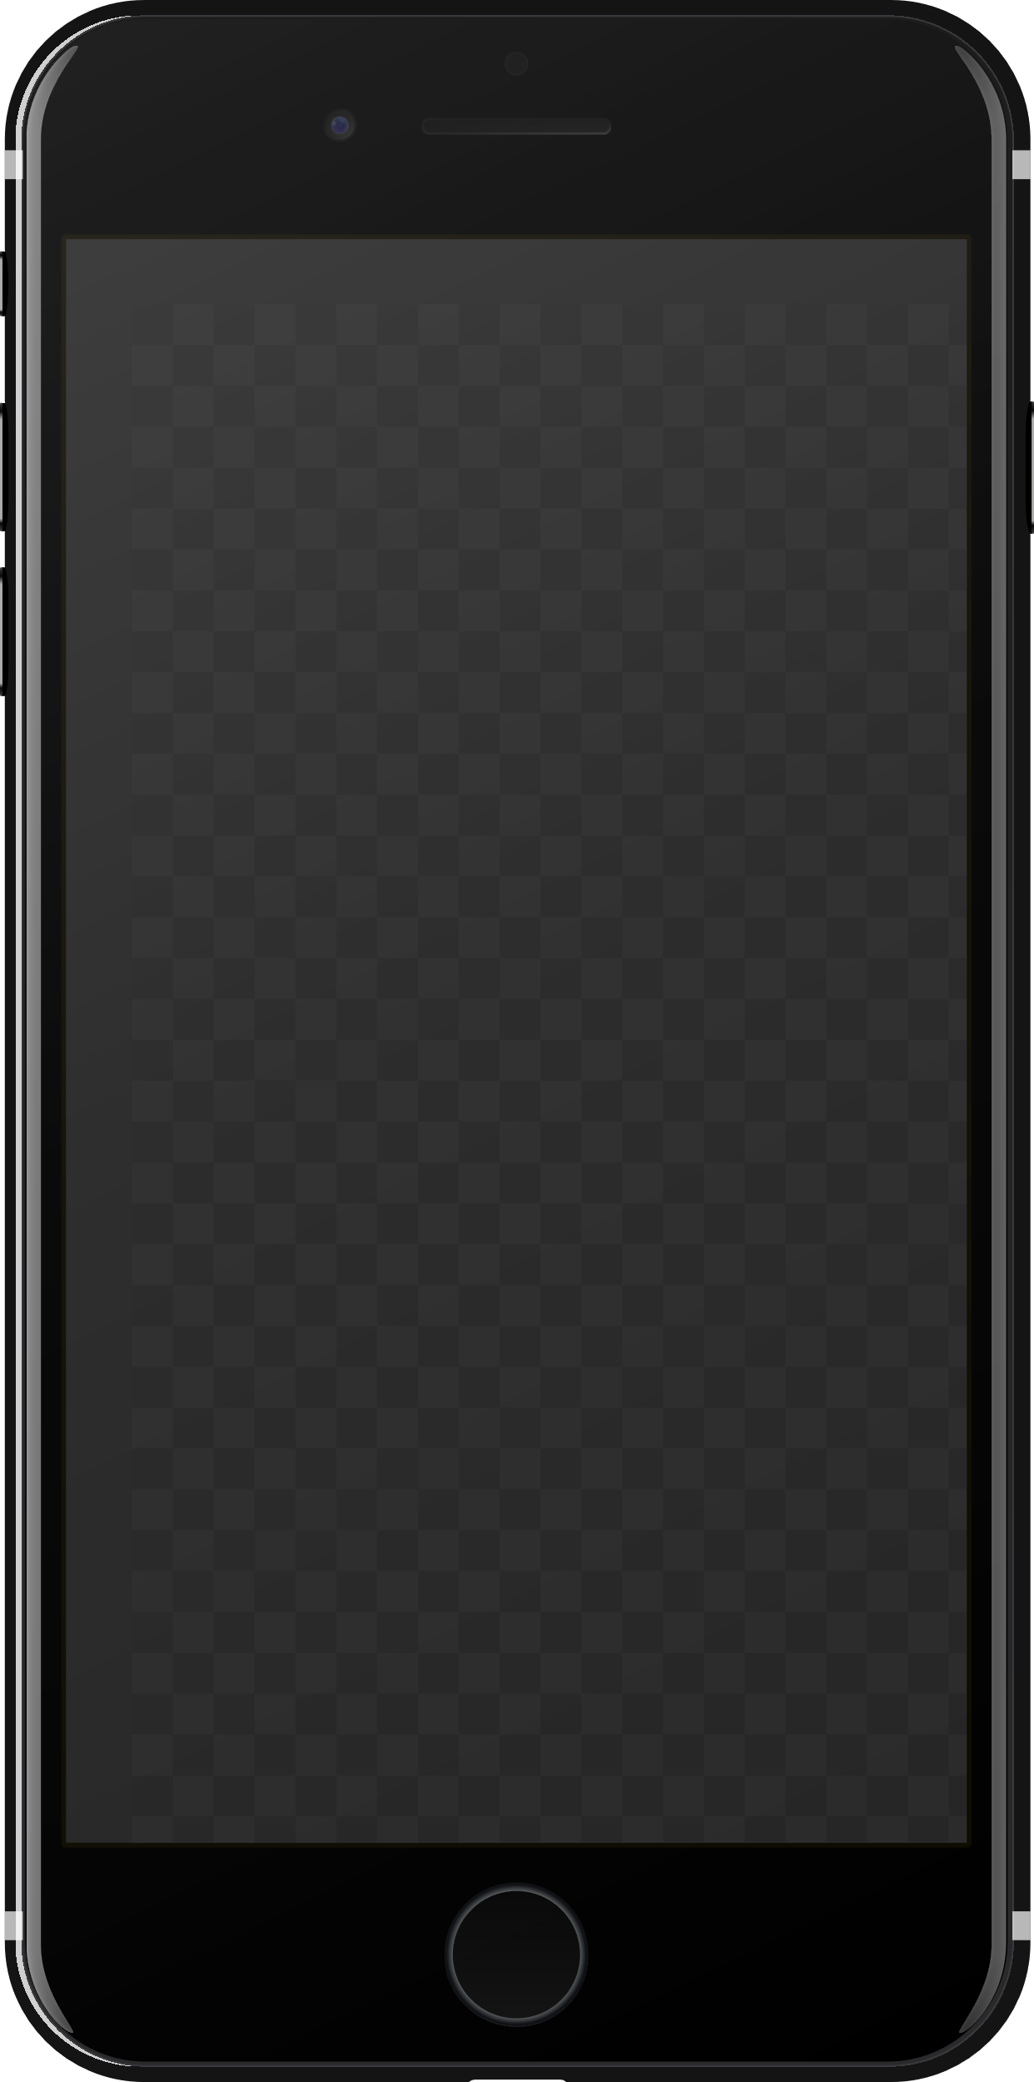
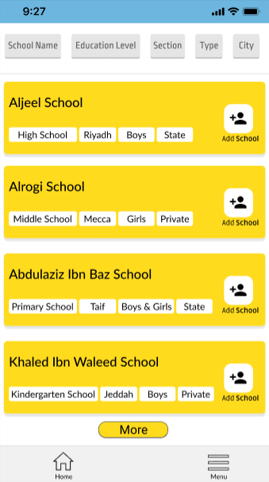
Home Screen

Slide 15
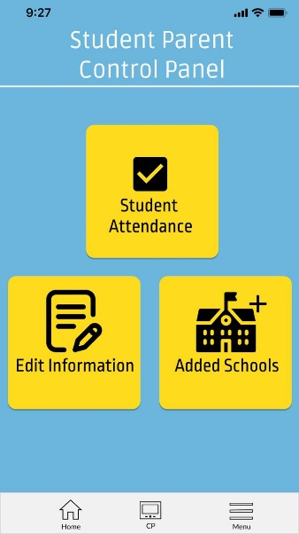
Student Parent Control Panel Screen

Slide 16
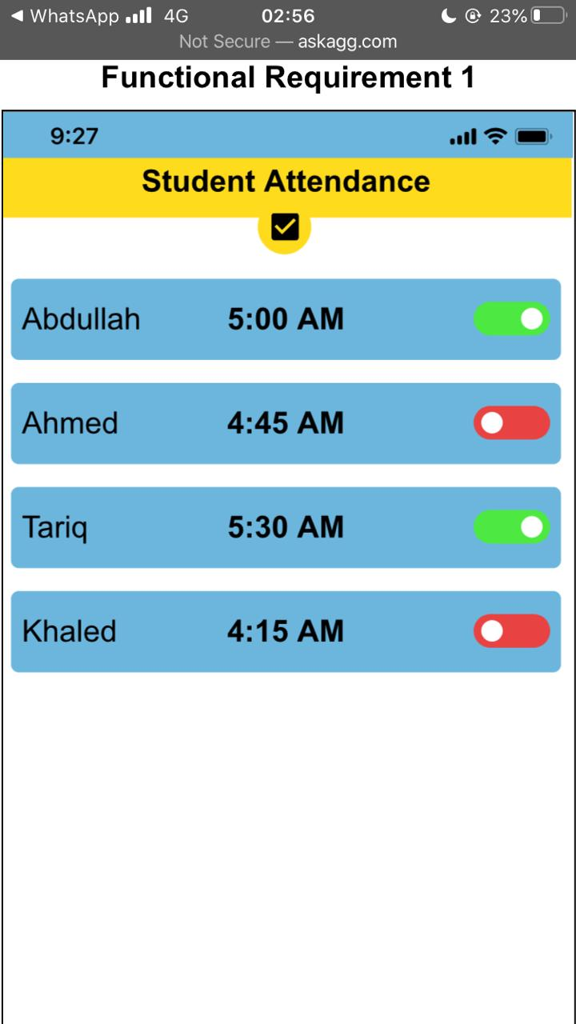
Student Attendance FR #1

Slide 17
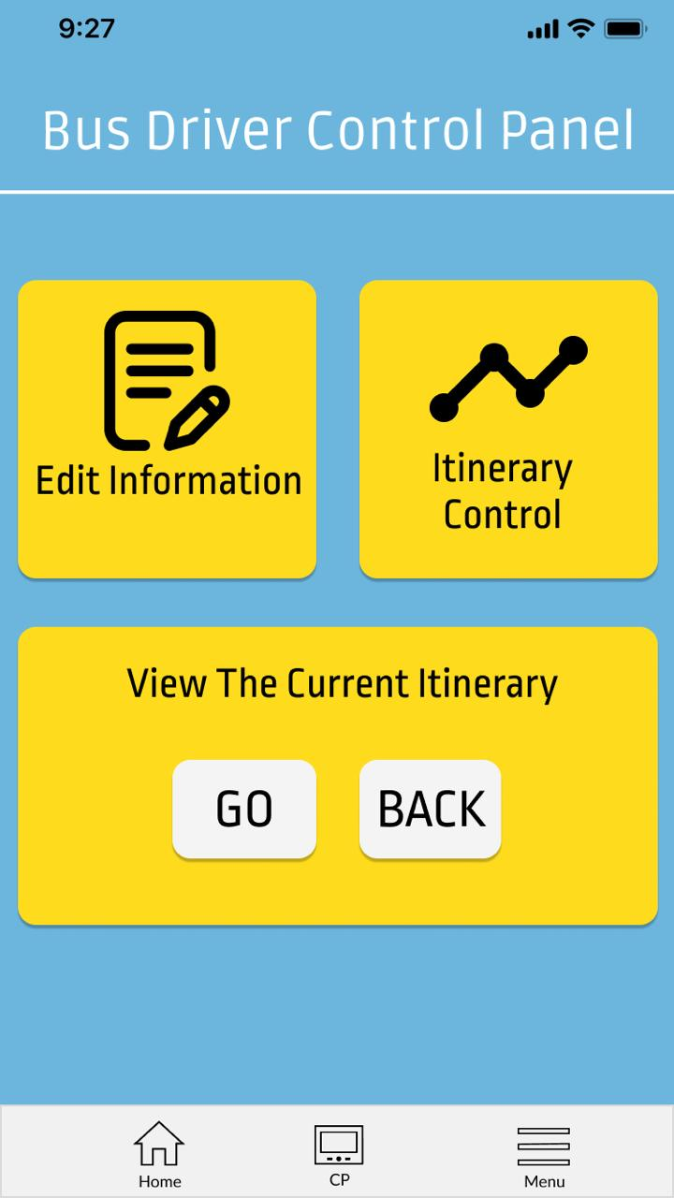
Bus Driver Control Panel Screen

Slide 18
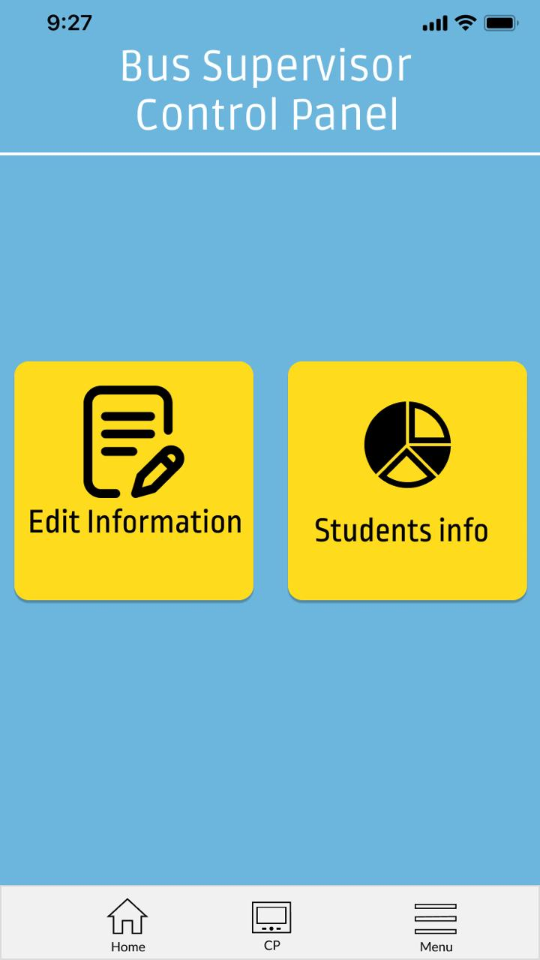
Bus Supervisor Control Panel Screen

Slide 19
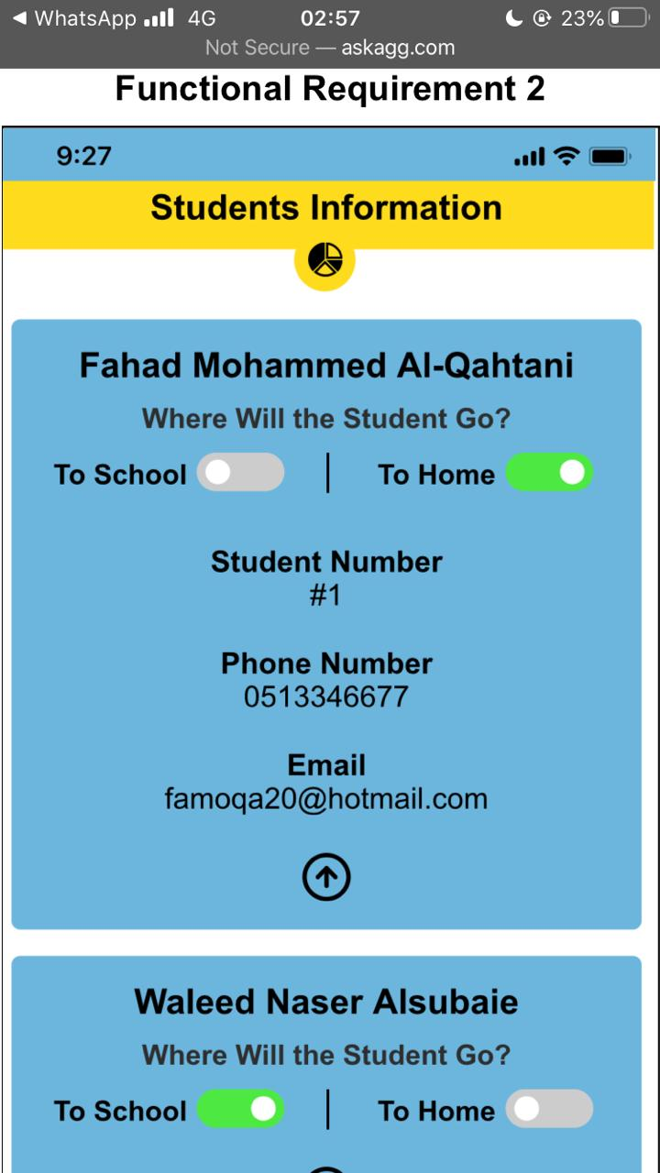
Student Information FR #2

Slide 20
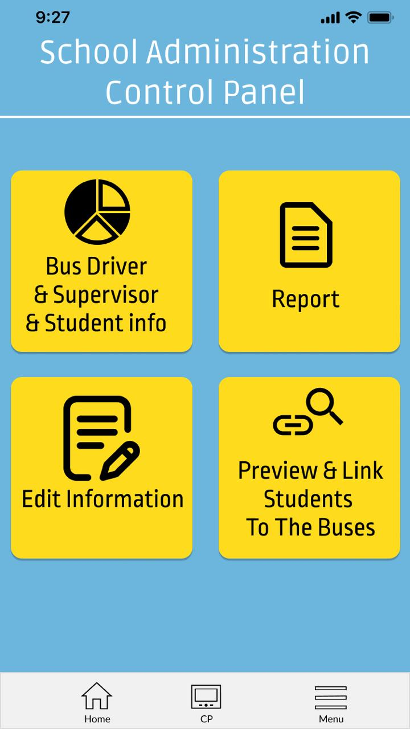
School Administration Control Panel Screen

Slide 21
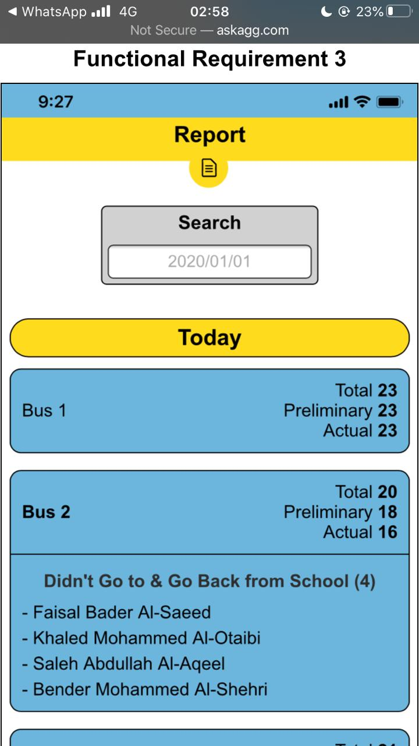
Report FR #3

Slide 22
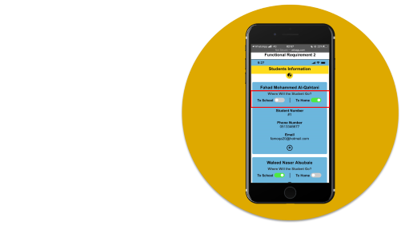
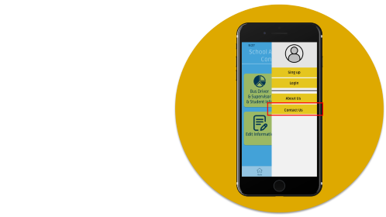
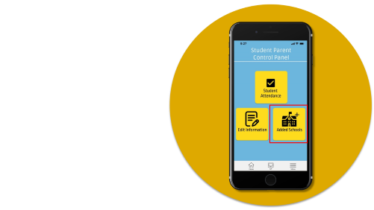
UI Design
Non-Functional Requirements
1
5
3
7
0
2
4
6

Slide 23
To School & To Home

Slide 24
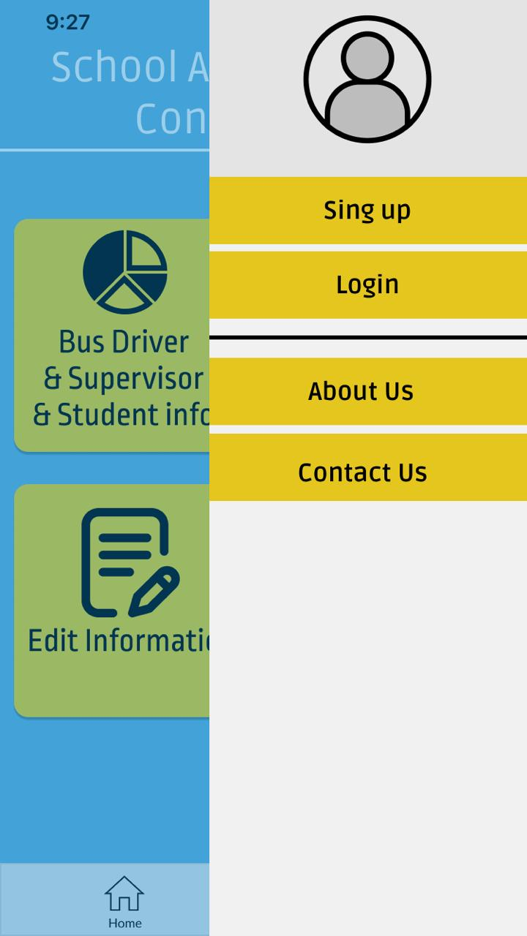
Contact With The Developer

Slide 25
Contact To Bus Drivers Supervisor

Slide 26


Slide 27



Team Contributions
Phase #2
Workshop
Phase #1
Phase #0
Phase #2
Phase #2
Workshop
Phase #1
Phase #0
Design the SSB diagrams
Design the SSB UI
Simple presentation of phase 0 & phase 1
Create the SRS document
Identify the SSB project idea
Definition what is Smart School Bus
most effective
most effective
most effective
most effective
Abdullah Alghamdi
Alwaleed Alghanim
Khaled Alqahtani
Khaled Alzouman
Rayan Aljowair
Abdullah Alghamdi
Alwaleed Alghanim
Khaled Alqahtani
Khaled Alzouman
Rayan Aljowair
Abdullah Alghamdi
Alwaleed Alghanim
Khaled Alqahtani
Khaled Alzouman
Rayan Aljowair
Abdullah Alghamdi
Alwaleed Alghanim
Khaled Alqahtani
Khaled Alzouman
Rayan Aljowair

Slide 28
Team Contributions
Phase #0
Phase #0
Identify the SSB project idea
Definition what is Smart School Bus
most effective
Abdullah Alghamdi
Alwaleed Alghanim
Khaled Alqahtani
Khaled Alzouman
Rayan Aljowair
Phase #2
Workshop
Phase #1
Phase #2
Phase #2
Workshop
Phase #1
Design the SSB diagrams
Design the SSB UI
Simple presentation of phase 0 & phase 1
Create the SRS document
most effective
most effective
most effective
Abdullah Alghamdi
Alwaleed Alghanim
Khaled Alqahtani
Khaled Alzouman
Rayan Aljowair
Abdullah Alghamdi
Alwaleed Alghanim
Khaled Alqahtani
Khaled Alzouman
Rayan Aljowair
Abdullah Alghamdi
Alwaleed Alghanim
Khaled Alqahtani
Khaled Alzouman
Rayan Aljowair

Slide 29
Team Contributions
Phase #2
Workshop
Phase #1
Phase #0
Phase #2
Phase #2
Workshop
Phase #1
Phase #0
Design the SSB diagrams
Design the SSB UI
Simple presentation of phase 0 & phase 1
Create the SRS document
Identify the SSB project idea
Definition what is Smart School Bus
most effective
most effective
most effective
most effective
Abdullah Alghamdi
Alwaleed Alghanim
Khaled Alqahtani
Khaled Alzouman
Rayan Aljowair
Abdullah Alghamdi
Alwaleed Alghanim
Khaled Alqahtani
Khaled Alzouman
Rayan Aljowair
Abdullah Alghamdi
Alwaleed Alghanim
Khaled Alqahtani
Khaled Alzouman
Rayan Aljowair
Abdullah Alghamdi
Alwaleed Alghanim
Khaled Alqahtani
Khaled Alzouman
Rayan Aljowair

Slide 30
Team Contributions
Phase #1
Phase #1
Create the SRS document
most effective
Abdullah Alghamdi
Alwaleed Alghanim
Khaled Alqahtani
Khaled Alzouman
Rayan Aljowair
Phase #2
Workshop
Phase #0
Phase #2
Phase #2
Workshop
Phase #0
Design the SSB diagrams
Design the SSB UI
Simple presentation of phase 0 & phase 1
Identify the SSB project idea
Definition what is Smart School Bus
most effective
most effective
most effective
Abdullah Alghamdi
Alwaleed Alghanim
Khaled Alqahtani
Khaled Alzouman
Rayan Aljowair
Abdullah Alghamdi
Alwaleed Alghanim
Khaled Alqahtani
Khaled Alzouman
Rayan Aljowair
Abdullah Alghamdi
Alwaleed Alghanim
Khaled Alqahtani
Khaled Alzouman
Rayan Aljowair

Slide 31
Team Contributions
Phase #2
Workshop
Phase #1
Phase #0
Phase #2
Phase #2
Workshop
Phase #1
Phase #0
Design the SSB diagrams
Design the SSB UI
Simple presentation of phase 0 & phase 1
Create the SRS document
Identify the SSB project idea
Definition what is Smart School Bus
most effective
most effective
most effective
most effective
Abdullah Alghamdi
Alwaleed Alghanim
Khaled Alqahtani
Khaled Alzouman
Rayan Aljowair
Abdullah Alghamdi
Alwaleed Alghanim
Khaled Alqahtani
Khaled Alzouman
Rayan Aljowair
Abdullah Alghamdi
Alwaleed Alghanim
Khaled Alqahtani
Khaled Alzouman
Rayan Aljowair
Abdullah Alghamdi
Alwaleed Alghanim
Khaled Alqahtani
Khaled Alzouman
Rayan Aljowair

Slide 32
Team Contributions
Workshop
Workshop
Simple presentation of phase 0 & phase 1
most effective
Abdullah Alghamdi
Alwaleed Alghanim
Khaled Alqahtani
Khaled Alzouman
Rayan Aljowair
Phase #2
Phase #1
Phase #0
Phase #2
Phase #2
Phase #1
Phase #0
Design the SSB diagrams
Design the SSB UI
Create the SRS document
Identify the SSB project idea
Definition what is Smart School Bus
most effective
most effective
most effective
Abdullah Alghamdi
Alwaleed Alghanim
Khaled Alqahtani
Khaled Alzouman
Rayan Aljowair
Abdullah Alghamdi
Alwaleed Alghanim
Khaled Alqahtani
Khaled Alzouman
Rayan Aljowair
Abdullah Alghamdi
Alwaleed Alghanim
Khaled Alqahtani
Khaled Alzouman
Rayan Aljowair

Slide 33
Team Contributions
Phase #2
Workshop
Phase #1
Phase #0
Phase #2
Phase #2
Workshop
Phase #1
Phase #0
Design the SSB diagrams
Design the SSB UI
Simple presentation of phase 0 & phase 1
Create the SRS document
Identify the SSB project idea
Definition what is Smart School Bus
most effective
most effective
most effective
most effective
Abdullah Alghamdi
Alwaleed Alghanim
Khaled Alqahtani
Khaled Alzouman
Rayan Aljowair
Abdullah Alghamdi
Alwaleed Alghanim
Khaled Alqahtani
Khaled Alzouman
Rayan Aljowair
Abdullah Alghamdi
Alwaleed Alghanim
Khaled Alqahtani
Khaled Alzouman
Rayan Aljowair
Abdullah Alghamdi
Alwaleed Alghanim
Khaled Alqahtani
Khaled Alzouman
Rayan Aljowair

Slide 34
Team Contributions
Phase #2
Phase #2
Phase #2
Design the SSB diagrams
Design the SSB UI
most effective
Abdullah Alghamdi
Alwaleed Alghanim
Khaled Alqahtani
Khaled Alzouman
Rayan Aljowair
Workshop
Phase #1
Phase #0
Workshop
Phase #1
Phase #0
Phase #3
Phase #2
Simple presentation of phase 0 & phase 1
Create the SRS document
Identify the SSB project idea
Definition what is Smart School Bus
Phase #3
most effective
most effective
most effective
Simple presentation of phase 2
Implement the UI
Abdullah Alghamdi
Alwaleed Alghanim
Khaled Alqahtani
Khaled Alzouman
Rayan Aljowair
Abdullah Alghamdi
Alwaleed Alghanim
Khaled Alqahtani
Khaled Alzouman
Rayan Aljowair
Abdullah Alghamdi
Alwaleed Alghanim
Khaled Alqahtani
Khaled Alzouman
Rayan Aljowair
most effective
Abdullah Alghamdi
Alwaleed Alghanim
Khaled Alqahtani
Khaled Alzouman
Rayan Aljowair

Slide 35
Team Contributions
Phase #3
Phase #2
Phase #3
Simple presentation of phase 2
Implement the UI
most effective
Abdullah Alghamdi
Alwaleed Alghanim
Khaled Alqahtani
Khaled Alzouman
Rayan Aljowair
Phase #2
Workshop
Phase #1
Phase #0
Phase #2
Phase #2
Workshop
Phase #1
Phase #0
Design the SSB diagrams
Design the SSB UI
Simple presentation of phase 0 & phase 1
Create the SRS document
Identify the SSB project idea
Definition what is Smart School Bus
most effective
most effective
most effective
most effective
Abdullah Alghamdi
Alwaleed Alghanim
Khaled Alqahtani
Khaled Alzouman
Rayan Aljowair
Abdullah Alghamdi
Alwaleed Alghanim
Khaled Alqahtani
Khaled Alzouman
Rayan Aljowair
Abdullah Alghamdi
Alwaleed Alghanim
Khaled Alqahtani
Khaled Alzouman
Rayan Aljowair
Abdullah Alghamdi
Alwaleed Alghanim
Khaled Alqahtani
Khaled Alzouman
Rayan Aljowair

Slide 36


Slide 37
Future Work
Expanding the scope to university.
Driver monitoring system
Surveillance cameras system
Tracking System

Slide 38


Slide 39
Conclusion
We would like to thank Mr.Sultan for the project journey.
we learn a lot of things in this course that will help us in the future. We wish all the best for all students in this class thank you all.

Slide 40
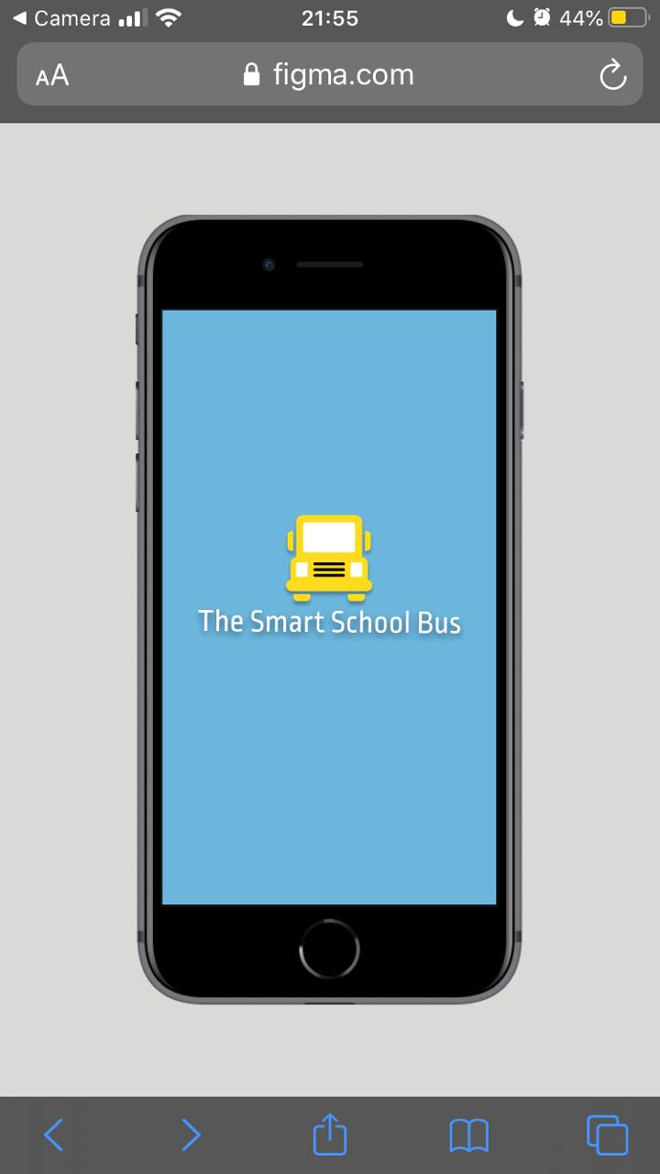
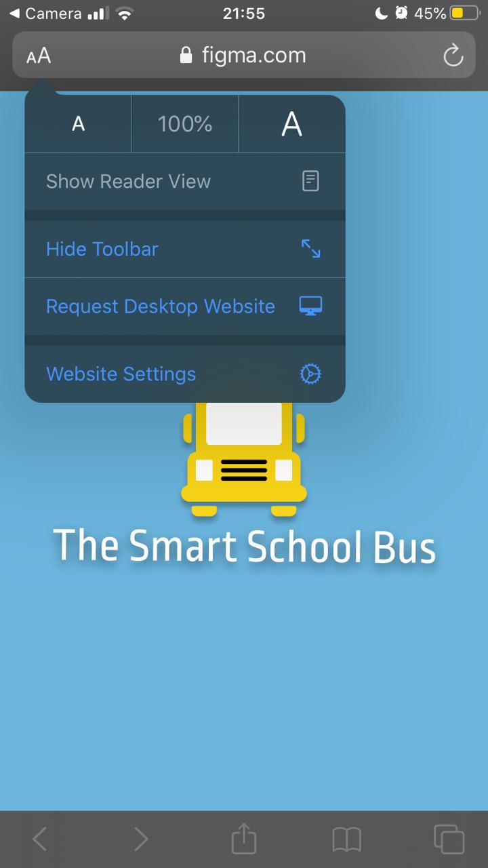

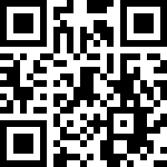
For better experience
Any questions?
Done !

Slide 41
For better experience
Any questions?
Done !

Slide 42
For better experience
Any questions?
Done !

